Slide 1
Leftover Food Collection and Composting business in New Delhi
Coursera Capstone Project
Ramanuj Mitra

Slide 2
Problem Statement
Food waste a critical issue in a populous, developing country like India
The state of Delhi or the National Capital Region (NCR) has a population of over 20 millions
Suitable location needed to set up a business to tackle food waste

Slide 3
Background
Leftover food collected from restaurants by the business
Quality check and storage for distribution among the needy
Spoilt food is to be composted and supplied to local nurseries (flower and horticulture)

Slide 4
Data
Foursquare API: data on restaurants and nurseries in New Delhi
Google API: data on local foodbanks, etc.
Restaurants with existing sustainability tags/initiatives to be preferred

Slide 5
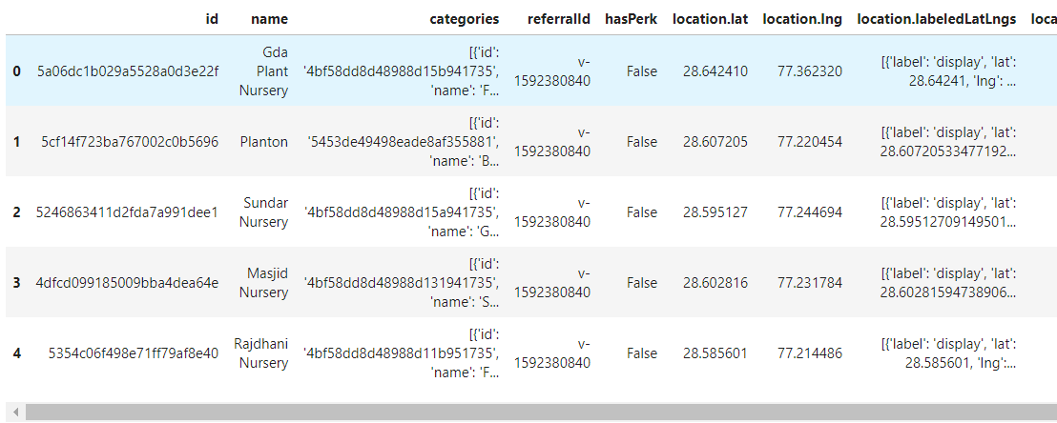
Methodology
Area with highest density of restaurants and nurseries is suitable
Below is the dataframe of nurseries, as queried from Foursquare

Slide 6
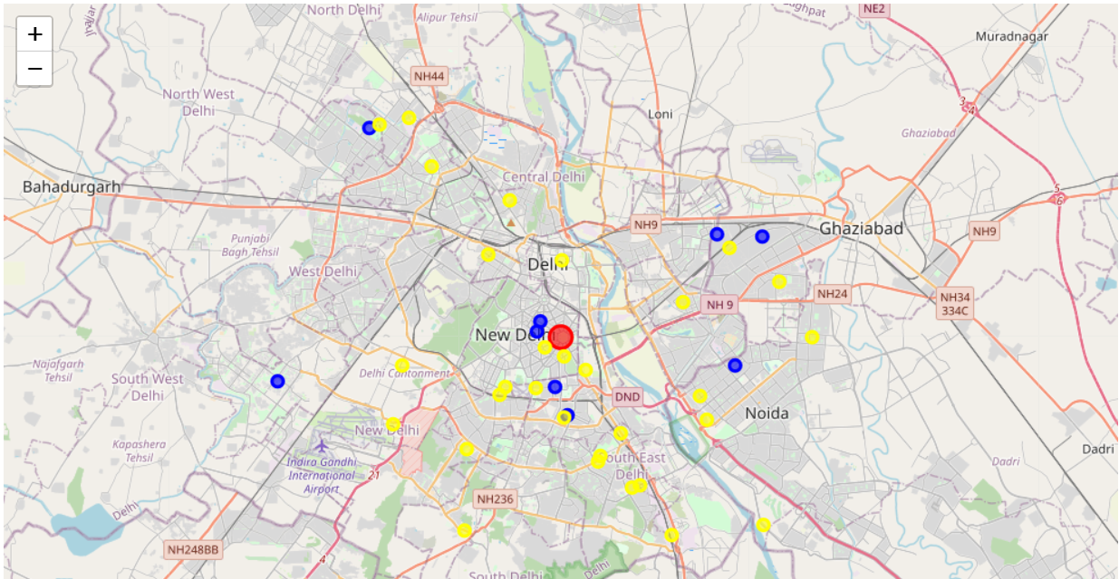
Results
Below is the superimposed map (restaurants + nurseries)

Slide 7
Discussion and Conclusion
The Central Delhi region was found to be a suitable location
Foursquare API is not suitable for studies using geographical locations in India – the data points are very few
For professional projects, Google API or other services should be explored

